Slide 1
Bloodstain Classification in Forensic Analysis
Using Optimized 3D CNN
Conference : 6th International Conference on Electrical Engineering and Information & Communication Technology (ICEEICT)
Authors List :
Md Al Amin Tokder
Tasmia Jannat
Prof. Dr. Md. Ali Hossain
Nazmul Haque
Notes:
Are your classroom colors different than what you see in this template? That’s OK! Click on Design -> Variants (the down arrow) -> Pick the color scheme that works for you!
Feel free to change any “You will…” and “I will…” statements to ensure they align with your classroom procedures and rules!

Slide 2
Outline
Introduction
Motivation
Related Works
Dataset
Proposed Methodology
Future Work
Reference
Objectives
Experimental Result
Conclusion
“Bloodstain Classification in Forensic Analysis Using Optimized 3D CNN“

Slide 3
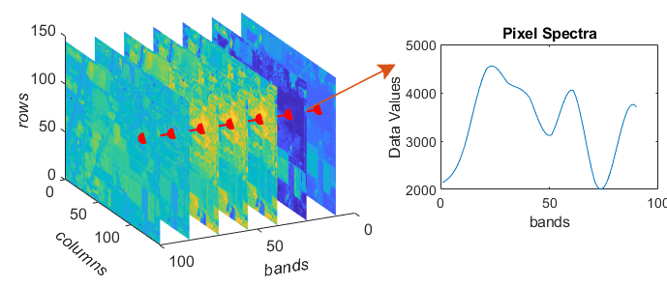
Introduction
Hyperspectral image involves capturing a large number of narrow and contiguous bands across the spectrum but traditional image, which captures three bands of information (red, green, and blue).
Provide high spectral and spatial resolution
Capture more detailed Information than normal images.
Figure-1 : Hyperspectral Image
“Bloodstain Classification in Forensic Analysis Using Optimized 3D CNN“

Slide 4
Motivation
Hyperspectral image capture high information
Provide details information of an image
Remote sensing ,agriculture ,medicine, blood
Analysis of bloodstain patterns , forensic investigation
Crime scene analysis
4
“Bloodstain Classification in Forensic Analysis Using Optimized 3D CNN“

Slide 5
Objective
To create a efficient method to identify substance classification in forensic science .
To get better accuracy
To capture both spectral and spatial information for analysis purpose
Dimensionality Reduction
5
“Bloodstain Classification in Forensic Analysis Using Optimized 3D CNN“

Slide 6
Related Works
Paper Title | Method Used | Limitation
“A Fast and 3D CNN for Hyperspectral Imaging-based Bloodstain Classification,” Forensic science international 2022 [1] | 1D,2D,3D Convolutional Neural Network | Accuracy = 95% Use PCA only for feature extraction
"Hyperspectral imaging for non-contact analysis of forensic traces,” Journal of Multidisciplinary Research at Trent 2019 [2] | Uses correlation coefficient in the visible region using reflectance spectroscopy to identify blood. | No use of Deep learning
“Blood stain classification with hyperspectral imaging and deep neural networks,” Science & Justice 2021 [3] | Multilayer Perceptron, Deep Recurrent Neural Network, | Use only one method (PCA) for feature extraction
“Bloodstain Classification in Forensic Analysis Using Optimized 3D CNN“

Slide 7
Problem Statement
Need Efficient feature extraction technique
Need a custom model for better accuracy
Forensic investigations heavily rely on the identification and classification of bloodstains
Traditional methods for bloodstain analysis in forensic science face limitations in terms of accuracy and efficiency.
“Bloodstain Classification in Forensic Analysis Using Optimized 3D CNN“

Slide 8
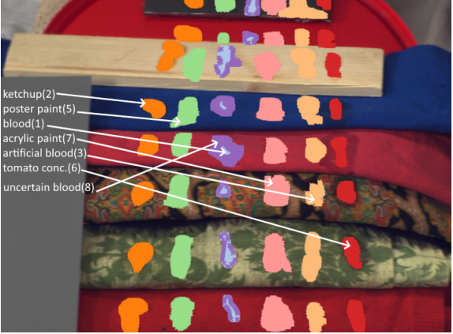
Dataset
The dataset is called “Hyperblood“ Hyperspectral-based Bloodstain dataset.
This dataset has different types of substances i.e., blood and blood-like compounds, for instance, ketchup, artificial blood, beetroot juice, poster paint, tomato concentrate, acrylic paint, uncertain blood.[1]
Dataset contains : 14 hyperspectral images (ENVI format)
Image size : 519 x 696 pixels (each pixel contains 113 band)
Number of Class : 7
Source : www.kaggle.com
Fig-1: Hyperblood dataset
“Bloodstain Classification in Forensic Analysis Using Optimized 3D CNN“

Slide 9
Dataset contains : 14 hyperspectral images (ENVI format)
Image size : 519 x 696 pixels (each pixel contains 113 band)
Number of Class : 7
# of Dimensions : 15
Shape of HSI (519, 696, 113)
Shape of GT (519, 696)
Name of Classes [0 1 2 3 4 5 6 7]
Source : www.kaggle.com
Fig-1: Hyperblood dataset
9
“Bloodstain Classification in Forensic Analysis Using Optimized 3D CNN“

Slide 10
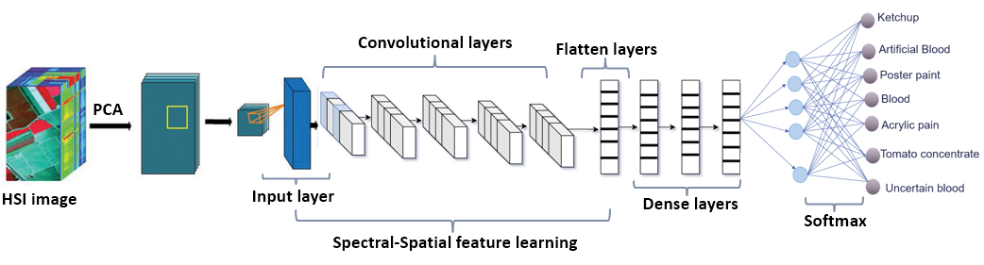
Proposed Methodology
Figure-2: Optimized 3D CNN
“Bloodstain Classification in Forensic Analysis Using Optimized 3D CNN“

Slide 11
Data Pre-Processing by PCA
Before PCA | After Applying PCA
Shape of HSI (519, 696, 113) | Create Image Cubes for Model Building Shape of HSI (33804, 9, 9, 15)
Shape of GT (519, 696) | Shape of GT (33804)
“Bloodstain Classification in Forensic Analysis Using Optimized 3D CNN“

Slide 12
Train , Test and Validation Sets ( 3D CNN Models)
Training (1690, 9, 9, 15, 1)
Validation (1690, 9, 9, 15, 1)
Test (30424, 9, 9, 15, 1)
Ratio of Train ,Validation and Test is : 5% : 5%: 90%
“Bloodstain Classification in Forensic Analysis Using Optimized 3D CNN“

Slide 13
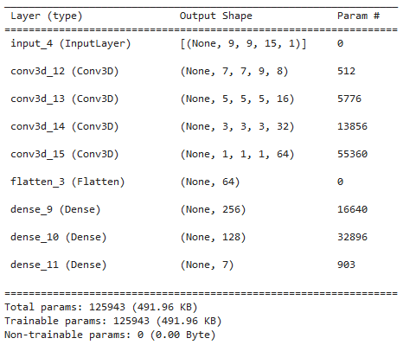
Optimized 3D CNN [1]
Number of Layers :
Convolution Layer: 4
Flatten layer:1
Dense layer:2
Output layer 1
Activation Function uses in layers:
Convolution Layer: Mish
Dense layer: Mish
Output layer : Softmax
Figure-3: Modified 3D CNN Model [1]
“Bloodstain Classification in Forensic Analysis Using Optimized 3D CNN“

Slide 14
Comparison Between Existing Methodology and Proposed Methodology
Existing 3D CNN | Optimized 3D CNN
Number of Layers : Convolution Layer: 4 Flatten layer: 1 Dense layer: 2 Output layer : 1 | Number of Layers : Convolution Layer: 3 Flatten layer: 1 Dense layer: 3 Output layer : 1
Activation Function uses in layers: Convolution Layer: Relu Dense layer: Relu Output layer : Softmax | Activation Function uses in layers: Convolution Layer: Mish Dense layer: Mish Output layer : Softmax
Accuracy: 95% | Accuracy: 97%
“Bloodstain Classification in Forensic Analysis Using Optimized 3D CNN“

Slide 15
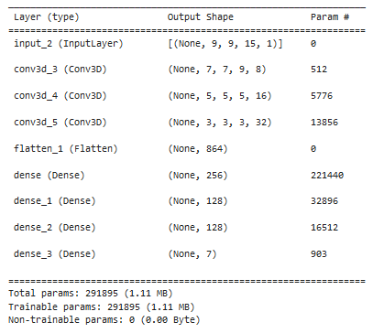
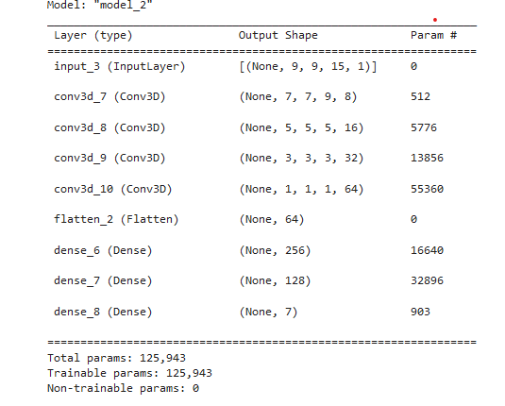
Existing 3D CNN | Optimized 3D CNN
“Bloodstain Classification in Forensic Analysis Using Optimized 3D CNN“

Slide 16
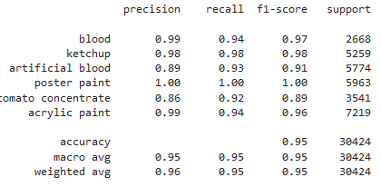
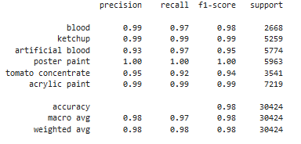
Existing 3D CNN (Result) | Modified 3D CNN (Result)
“Bloodstain Classification in Forensic Analysis Using Optimized 3D CNN“

Slide 17
Classifier Performance :
Classifiers | Accuracy | Macro avg | Weighted avg | Parameter
3D CNN | 0.95 | 0.95 | 0.95 | 291895
Optimized 3D CNN | 0.97 | 0.96 | 0.97 | 125943
“Bloodstain Classification in Forensic Analysis Using Optimized 3D CNN“

Slide 18
Classification Result : Existing 3D CNN vs Modified 3D CNN
Comparison Between Existing Methodology and Proposed Methodology
Type | Precision Existing Modified |  | Recall Existing Modified |  | F1-score Existing Modified |  | Support Existing Modified
Blood | 0.99 | 0.99 | 0.94 | 0.97 | 0.97 | 0.98 | 2668 | 2668
KetChup | 0.98 | 0.99 | 0.98 | 0.99 | 0.98 | 0.99 | 5259 | 5259
Artificial blood | 0.89 | 0.93 | 0.93 | 0.97 | 0.91 | 0.95 | 5774 | 5774
Poster paint | 1.00 | 1.00 | 1.00 | 1.00 | 1.00 | 1.00 | 5963 | 5963
Tomato concentrate | 0.86 | 0.95 | 0.92 | 0.92 | 0.89 | 0.94 | 3541 | 3541
Acrylic paint | 0.99 | 0.99 | 0.94 | 0.99 | 0.96 | 0.99 | 7219 | 7219
Accuracy |  |  |  |  | 0.95 | 0.98 | 30424 | 30424
Macro avg | 0.95 | 0.98 | 0.95 | 0.97 | 0.95 | 0.98 | 30424 | 30424
Weighted avg | 0.96 | 0.98 | 0.95 | 0.98 | 0.95 | 0.98 | 30424 | 30424
“Bloodstain Classification in Forensic Analysis Using Optimized 3D CNN“

Slide 19
ReLU vs Mish Activation function :
Activation Function | Relu (Existing 3D CNN ) |  | Mish (Proposed 3D CNN)
Epochs Number | Training Accuracy | Validation Accuracy | Training Accuracy | Validation Accuracy
1 | 0.3361 | 0.6373 | 0.4917 | 0.5793
2 | 0.3876 | 0.8479 | 0.6414 | 0.6976
3 | 0.3767 | 0.9136 | 0.7586 | 0.8343
4 | 0.9112 | 0.9219 | 0.8710 | 0.8982
5 | 0.9272 | 0.9414 | 0.9077 | 0.9260
6 | 0.9473 | 0.9349 | 0.9337 | 0.9379
7 | 0.9574 | 0.9355 | 0.9432 | 0.9550
8 | 0.9568 | 0.9562 | 0.9556 | 0.9592
9 | 0.9728 | 0.9627 | 0.9556 | 0.9592
10 | 0.9746 | 0.9621 | 0.9722 | 0.9669
19
“Bloodstain Classification in Forensic Analysis Using Optimized 3D CNN“

Slide 20
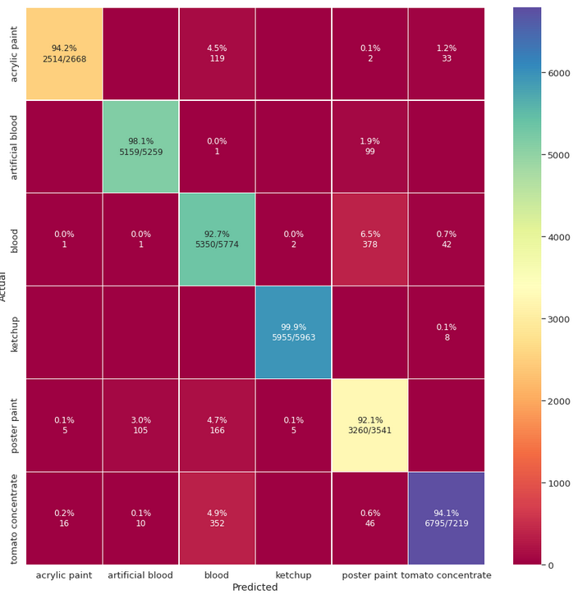
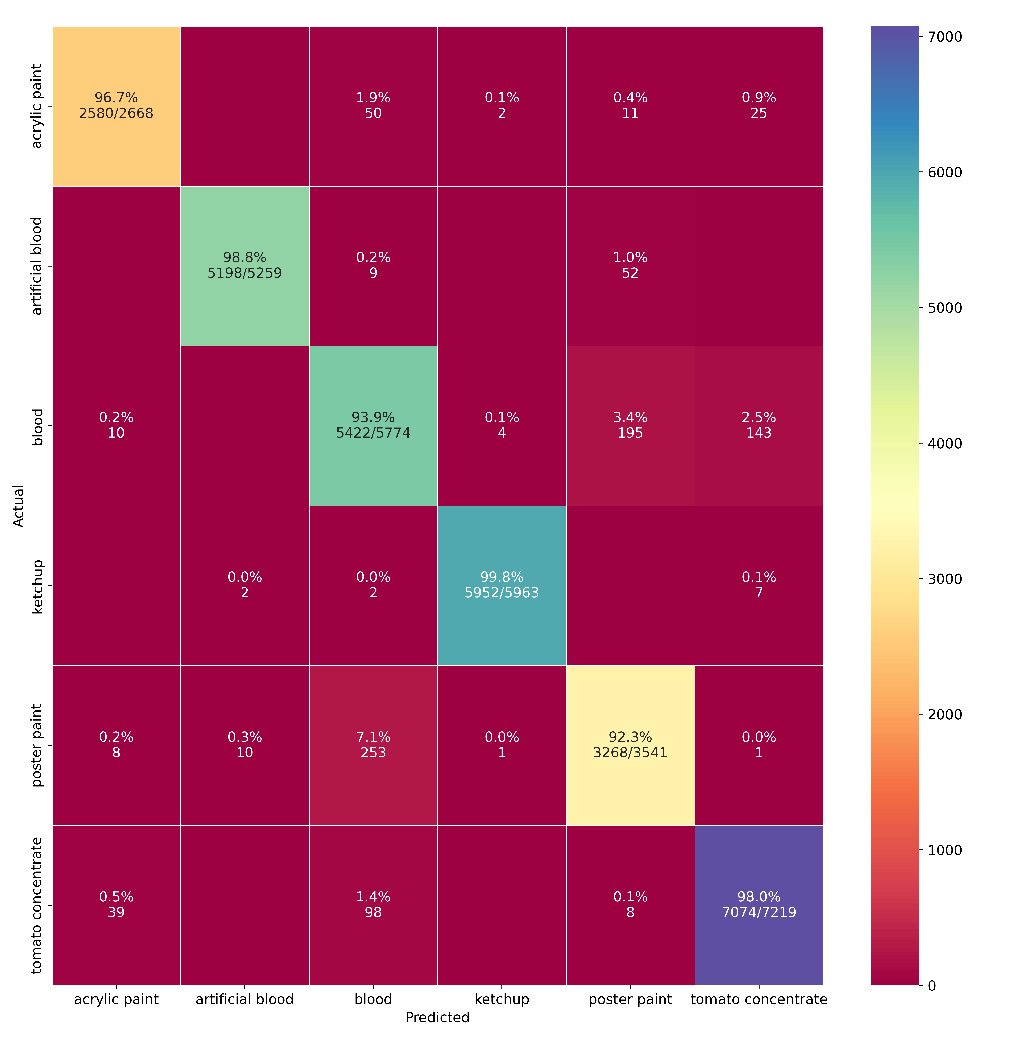
Confusion Matrix
Existing 3D CNN | Modified 3D CNN
“Bloodstain Classification in Forensic Analysis Using Optimized 3D CNN“

Slide 21
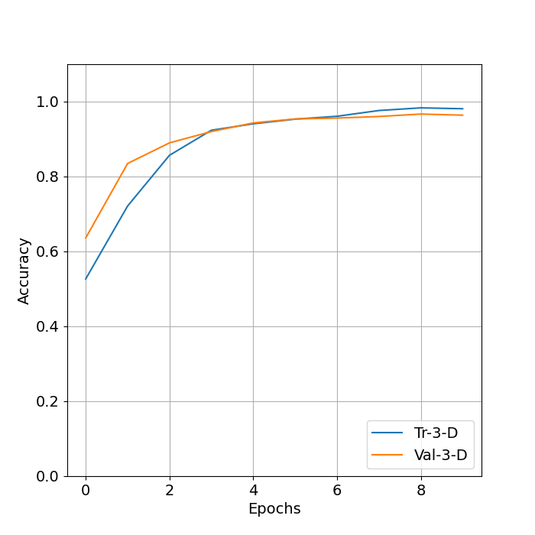
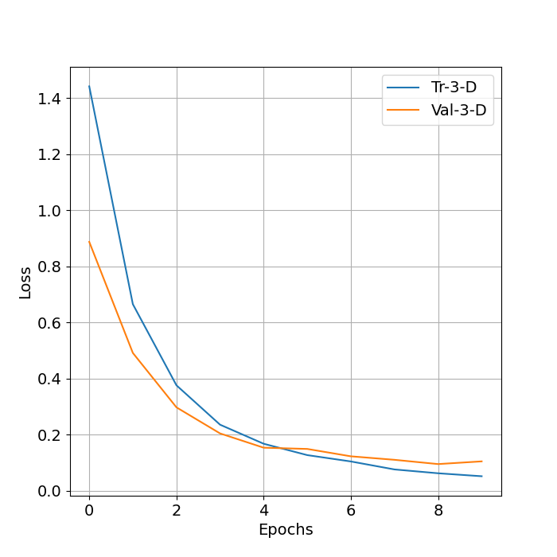
Train Vs Epoch curve for modified 3D CNN :
Figure-4: Accuracy vs Epochs curve
Figure-5: Loss vs Epochs curve
“Bloodstain Classification in Forensic Analysis Using Optimized 3D CNN“

Slide 22
Future Work
Optimize and modify in the convolutional layer
Apply different feature extraction method for better accuracy
“Bloodstain Classification in Forensic Analysis Using Optimized 3D CNN“

Slide 23
Conclusion:
The modified 3D CNN model gives us 97% accuracy whereas existing model gives 95% accuracy
We can say that if we changes some layer and use Mish activation function instead of ReLU then we get better accuracy .
“Bloodstain Classification in Forensic Analysis Using Optimized 3D CNN“

Slide 24
References
[1] Muhammad Ahmad, Jian Ping Li ,Ramil Kuleev, Muhammad Hassaan Farooq Butt, “A Fast and 3D CNN for Hyperspectral Imaging-based Bloodstain Classification”. Forensic science international, vol. 223, no. 1-3, pp. 28–39, 2022
[2] G. Edelman, E. Gaston, T. Van Leeuwen, P. Cullen, and M. Aalders,“Hyperspectral imaging for non-contact analysis of forensic traces,” Forensic science international, vol. 223, no. 1-3, pp. 28–39, 2021
[3] S. Cadd, B. Li, P. Beveridge, W. T. O’Hare, A. Campbell, and M. Islam, “The non-contact detection and identification of blood stained fingerprints using visible wavelength hyperspectral imaging: Part iieffectiveness on a range of substrates,” Science & Justice, vol. 56, no. 3, pp. 191–200, 2016.
[4] B. Li, P. Beveridge, W. T. O’Hare, and M. Islam, “The application of visible wavelength reflectance hyperspectral imaging for the detection and identification of blood stains,” Science & justice, vol. 54, no. 6, pp.
432–438, 2014.
“Bloodstain Classification in Forensic Analysis Using Optimized 3D CNN“

Slide 25
References
[5] R. Schalike and M. Illes, “A review of spectroscopic methods applied to bloodstain pattern analysis,” Journal of Multidisciplinary Research at Trent, vol. 2, no. 1, pp. 90–104, 2019.
“Bloodstain Classification in Forensic Analysis Using Optimized 3D CNN“

Slide 26
Thank You

